Slide 1
Options pricing with Python
“All of science is dominated by the idea of approximation”

Slide 2
The language of options
A call is a right to buy or take a long position in the underlying at fixed price at a future date.
A put is a right to sell or take a short position in the underlying.
Why do option traders trade options?
Traders in the underlying markets take directional bets.
Option traders are more interested in the speed with which the market moves. Option traders are buying and selling volatilities.

Slide 3
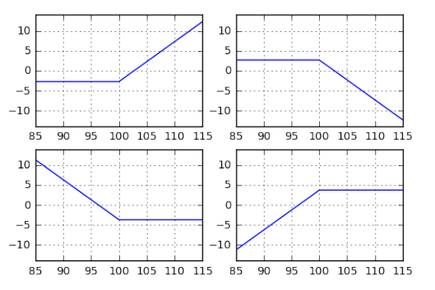
The risk and reward in options trading
Say a $100 call option is trading at $2.70 and $100 put sells at $3.70. The profit and loss of calls and puts at expiration look like this.

Slide 4
The risk and reward in options trading
Buyers of options have limited risk, potentially unlimited reward; sellers of options have limited reward, unlimited risk.
Why would anyone ever want to do anything other than buy options?
Option traders learn that unlimited risk/reward are not the only considerations. At-least as important, is the probability of unlimited profit or loss.
The trader must consider the likelihood of various outcomes.

Slide 5

Games of chance
Consider a roulette bet. The American Roulette has 38 pockets, numbered 1 through 36, and 0, 00. Suppose a casino allows a player to choose a number.

Slide 6
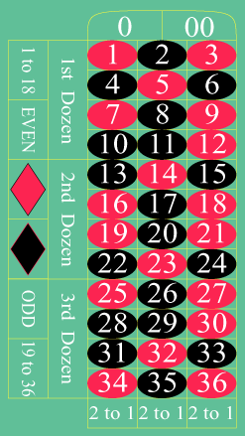
Games of chance
High-rollers or whales wager large sums of money, like a million dollars!
The croupier spins the wheel in one direction and spins the ball in the opposite direction.
Bet Name | Winning Spaces | Payout
Straight up | Any single number | 36:1
Split | Any two adjoining numbers vertical/horizontal | 17:1
Street | Any three numbers horizontal | 12:1
Corner | Any four adjoining numbers in a block(e.g. 1,2,4,5) | 10:1

Slide 7
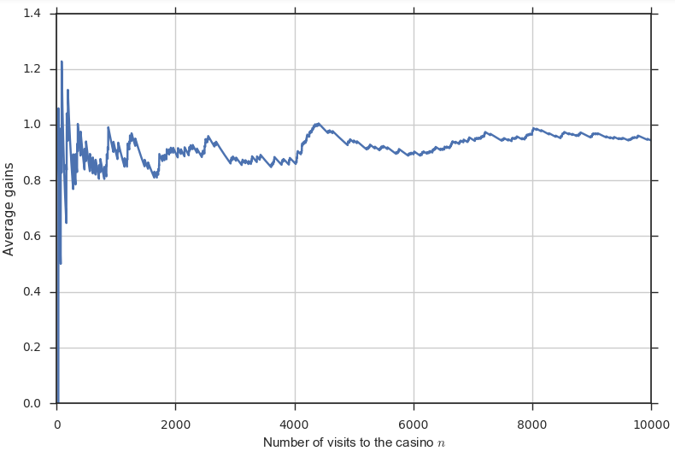

Games of chance
How much would you pay for the priviledge of picking a number at the roulette table?
Of course, no casino will let you buy such a bet for $0.95. Under those conditions, the casino would make no profit. In the real world, the player who wants to purchase such a bet will have to pay more, typically $1.
$$\frac{1}{38}×36=0.95$$

Slide 8
Option Price
The value of a proposition is the price one would expect to pay in order to break even in the long run.
How might we adapt the concepts of expected return to the pricing of options?
Option pricing models propose a series of prices and the possible probabilities for the underlying.

Slide 9



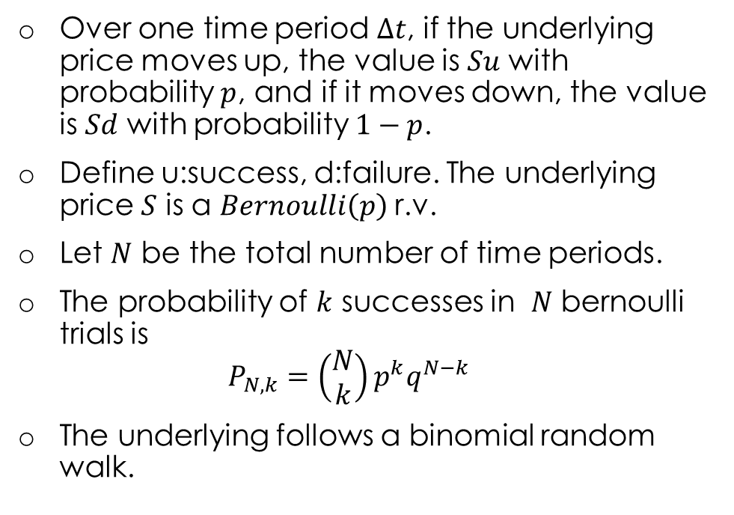



Binomial tree algorithm – vanilla options
Over one time period $∆t$, if the underlying price moves up, the value is $Su$ with probability $p$, and if it moves down, the value is $Sd$ with probability $1−p$.
Define u:success, d:failure. The underlying price $S$ is a $Bernoulli\left(p\right)$r.v.
Let $N$ be the total number of time periods.
The probability of $k$ successes in $N$ bernoulli trials is $P_{N,k}=\left(\begin{matrix}N \\ k\end{matrix}\right)p^{k}q^{N−k}$
The underlying follows a binomial random walk.
$$i$$
$$C\left[i+1\right][j+1]$$
$$p$$
$$C\left[i\right][j]$$
$$q$$
$$C\left[i+1\right][j]$$

Slide 10
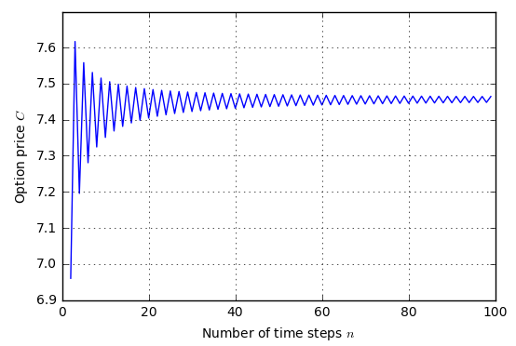
Binomial tree algorithm – vanilla options
Binomial tree algorithm for European calls
# Initialize all the asset prices for i in range(N+1): for j in range(i+1): S[i][j]=S[0][0]*(u**j)*(d**(i-j)) # Initialize the option values at maturity for j in range(N+1): if optionType == 'C': C[N][j] = max(S[N][j]-strike,0) else: C[N][j] = max(strike-S[N][j],0) # Work backwards through the tree for i in range(N-1,-1,-1): for j in range(i+1): C[i][j]=disc*(p*C[i+1][j+1] +(1-p)*C[i+1][j])
The binomial tree algorithm starts with the terminal payoffs and applies backward induction.
Quadratic space and running time.

Slide 11







Binomial tree algorithm – vanilla options
$$max⁡(Su^{3}−X,0)$$
The binomial tree algorithm starts from the last period and works its way towards the current period.
The memory requirement can be reduced if the space is reduced.
Specifically, we replace C[N+1][N+1] with a one-dimensional array of size N+1, C[N+1].
Such a one-dimensional array captures a strip in time.
We sweep this strip backward in time to compute the values at intermediate nodes.
$$C[0]$$
$$max⁡(Su^{2}d−X,0)$$
$$C[1]$$
$$max⁡(Sud^{2}−X,0)$$
$$C[2]$$
$$max⁡(Sd^{3}−X,0)$$

Slide 12
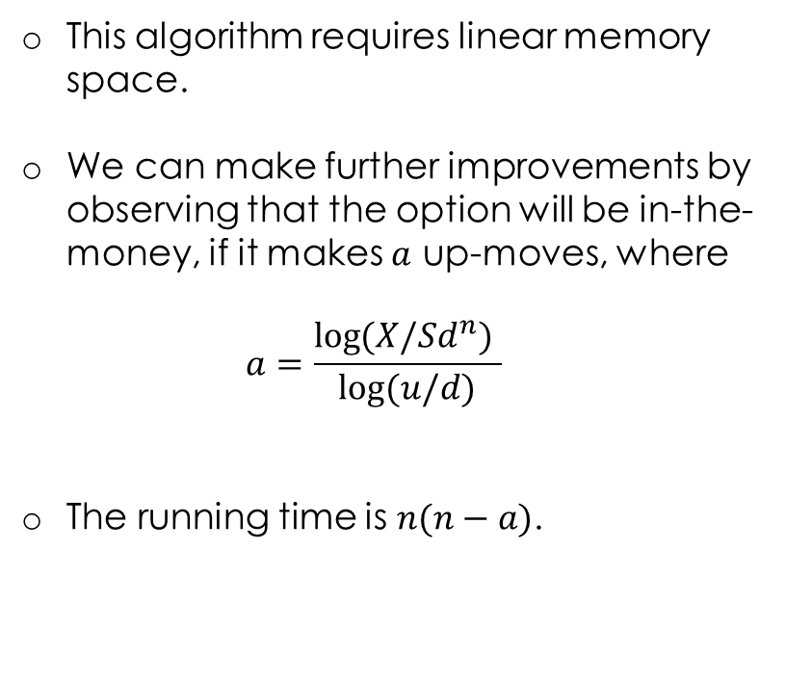
Binomial tree algorithm – vanilla options
Binomial tree algorithm for European calls – Linear space
a = math.log(X/(S*(d**N)))/math.log(u/d) a = math.ceil(a)
# Initialize the option values at maturity for j in range(N+1): if optionType == 'C': C[j] = max((S*(u**(N-j))*(d**j)) - X,0) elif optionType == 'P': C[j] = max(X - (S*(u**(N-j))*(d**j)),0)
# Work backwards through the tree for i in range(N-1,-1,-1): for j in range(min(N-a+1,i+1)): C[j]=disc*(p*C[j]+q*C[j+1])
This algorithm requires linear memory space.
We can make further improvements by observing that the option will be in-the-money, if it makes $a$ up-moves, where $a=\frac{\log{(X/Sd^{n}) }}{\log{(u/d)}}$
The running time is $n(n−a)$.

Slide 13

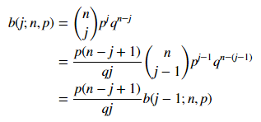
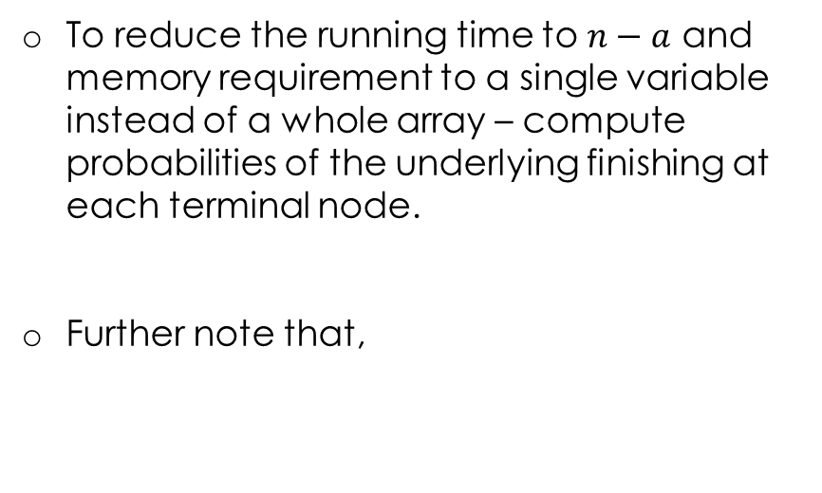
Binomial tree algorithm – vanilla options
An optimal algorithm – linear running time
# Binomial tree algorithm using a single variable # instead of a whole array and linear running time S = S * (u**a) * (d**(N-a)) b = (math.factorial(N)/(math.factorial(N-a)*math.factorial(a))) \ * (p**a) * (q**(N-a))
C = disc * b * (S-X)
for j in range(a+1,N+1): b = ((p*(N-j+1)) / (q*j)) * b S = S * (u/d) C = C + disc * b * (S-X)
To reduce the running time to $n−a$ and memory requirement to a single variable instead of a whole array – compute probabilities of the underlying finishing at each terminal node.
Further note that,

Slide 14
Binomial tree algorithm – vanilla options
Binomial tree algorithm for American Puts
# Initialize all the asset prices for i in range(N+1): for j in range(i+1): S[i][j]=S[0][0]*(u**j)*(d**(i-j))
# Initialize the option values at maturity for j in range(N+1): P[N][j] = max(strike-S[N][j],0)
# Work backwards through the tree for i in range(N-1,-1,-1): for j in range(i+1): P[i][j]=max(disc*(p*P[i+1][j+1] +(1-p)*P[i+1][j]), strike-S[i][j])
Early exercise has to be considered when pricing American puts.
Because, the person who exercises the put receives the strike price and earns the time value of money, there is incentive for early exercise
For American puts, at each intermediate node, check for early exercise, by comparing the intrinsic value if exercised with continuation.

Slide 15
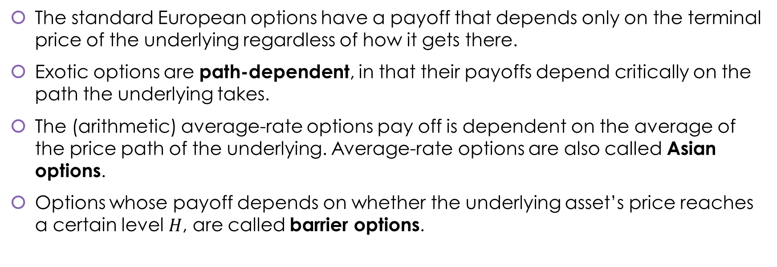
Exotic options
The standard European options have a payoff that depends only on the terminal price of the underlying regardless of how it gets there.
Exotic options are path-dependent, in that their payoffs depend critically on the path the underlying takes.
The (arithmetic) average-rate options pay off is dependent on the average of the price path of the underlying. Average-rate options are also called Asian options.
Options whose payoff depends on whether the underlying asset’s price reaches a certain level $H$, are called barrier options.

Slide 16



Barrier Options
In options start their lives worthless and are knocked in, when the barrier is hit.
Out options start their lives active but are knocked out, when the barrier is hit.
A down-and-in call becomes active when the spot prices moves below the barrier.
$$X$$
$$S$$
$$H$$
Down-and-in call

Slide 17
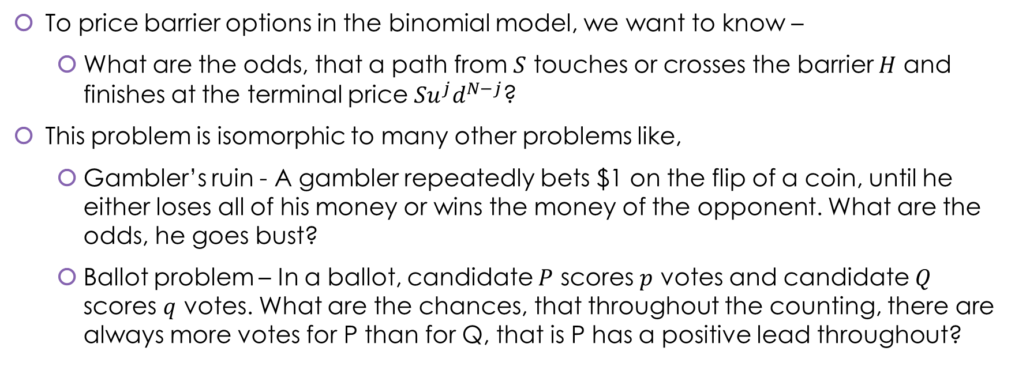
Pricing down-and-in barrier options
To price barrier options in the binomial model, we want to know –
What are the odds, that a path from $S$ touches or crosses the barrier $H$ and finishes at the terminal price ${Su}^{j}d^{N−j}$?
This problem is isomorphic to many other problems like,
Gambler’s ruin - A gambler repeatedly bets $1 on the flip of a coin, until he either loses all of his money or wins the money of the opponent. What are the odds, he goes bust?
Ballot problem – In a ballot, candidate $P$ scores $p$ votes and candidate $Q$ scores $q$ votes. What are the chances, that throughout the counting, there are always more votes for P than for Q, that is P has a positive lead throughout?

Slide 18

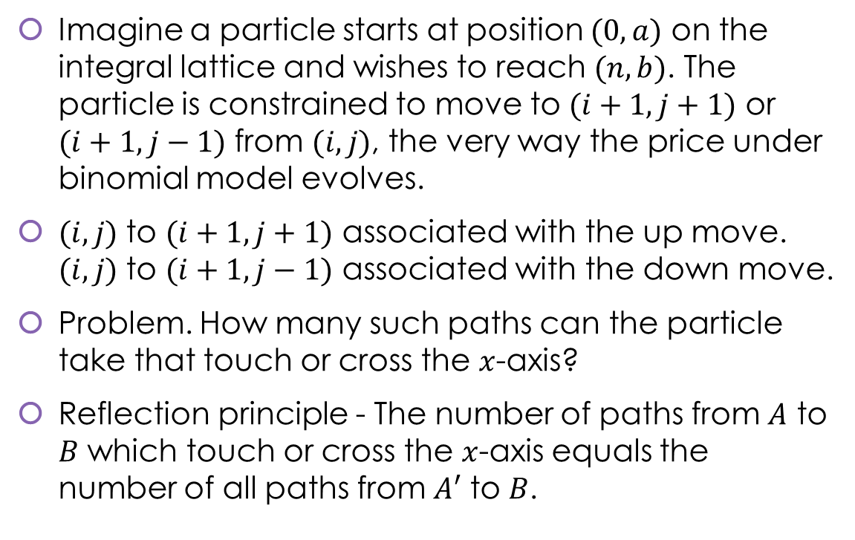


Reflection principle and pricing barrier options
Imagine a particle starts at position $(0,a)$ on the integral lattice and wishes to reach $(n,b)$. The particle is constrained to move to $(i+1,j+1)$ or $(i+1,j−1)$ from $(i,j)$, the very way the price under binomial model evolves.
$(i,j)$ to $(i+1,j+1)$ associated with the up move. $(i,j)$ to $(i+1,j−1)$ associated with the down move.
Problem. How many such paths can the particle take that touch or cross the $x$-axis?
Reflection principle - The number of paths from $A$ to $B$ which touch or cross the $x$-axis equals the number of all paths from $A′$ to $B$.
$$B$$
$$A$$
$$A^{′}$$

Slide 19
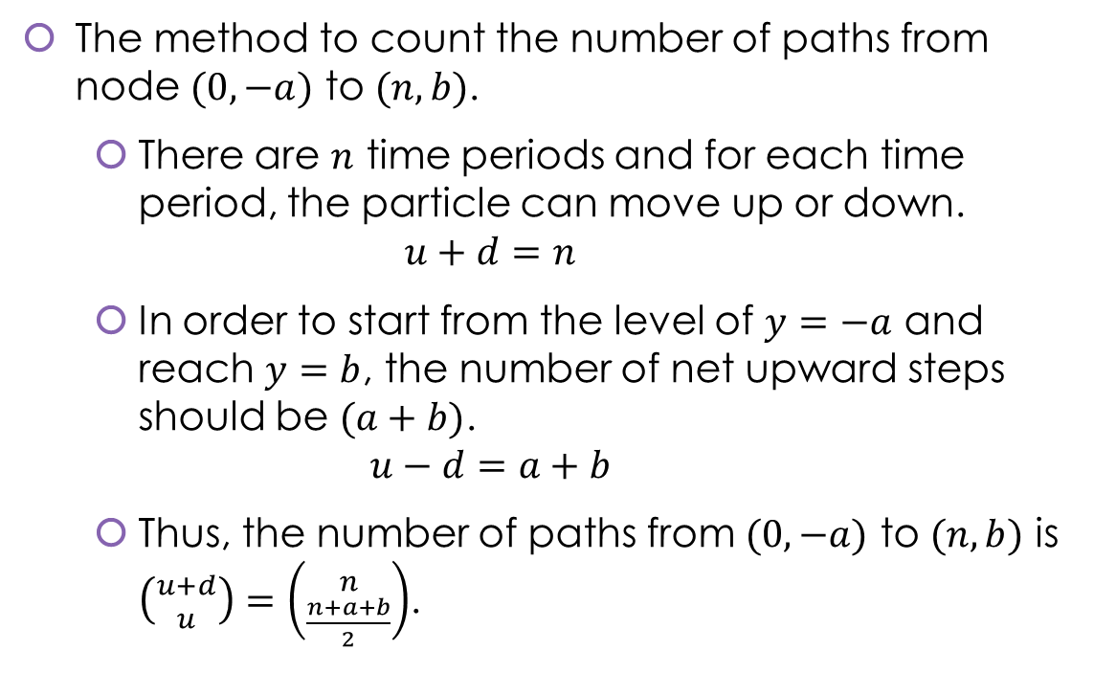
Reflection principle and pricing barrier options
The method to count the number of paths from node $(0,−a)$ to $(n,b)$.
There are $n$ time periods and for each time period, the particle can move up or down. $u+d=n$
In order to start from the level of $y=−a$ and reach $y=b$, the number of net upward steps should be $(a+b)$. $u−d=a+b$
Thus, the number of paths from $(0,−a)$ to $(n,b)$ is $\left({u+d \atop u}\right)=\left({n \atop \frac{n+a+b}{2}}\right)$.
$$B$$
$$A$$
$$A^{′}$$

Slide 20





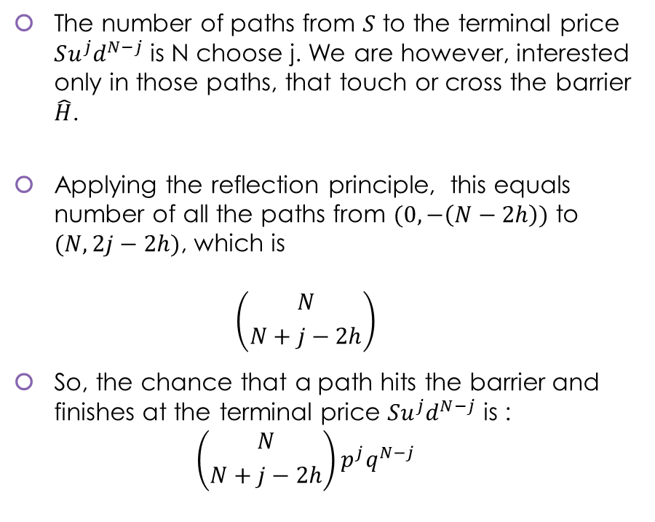



Pricing down-and-in barrier options
The number of paths from $S$ to the terminal price $Su^{j}d^{N−j}$ is N choose j. We are however, interested only in those paths, that touch or cross the barrier $\hat{H}$.
Applying the reflection principle, this equals number of all the paths from $(0,−\left(N−2h\right))$ to $(N,2j−2h)$, which is $\left({N \atop N+j−2h}\right)$
So, the chance that a path hits the barrier and finishes at the terminal price $Su^{j}d^{N−j}$ is : $\left({N \atop N+j−2h}\right)p^{j}q^{N−j}$
$$Su^{j}d^{N−j}$$
$$\hat{X}$$
$$S$$
$$2j$$
$$2a$$
$$\hat{H}$$
$$N$$
$$2h$$

Slide 21
Binomial tree algorithm – down and in barrier options
Binomial tree algorithm for down-and-in call
a = math.log(X/(S*(d**N)))/math.log(u/d) a = math.ceil(a) h = math.log(H/(S*(d**N)))/math.log(u/d) h = math.floor(h)
# Risk-neutral probabilities p = (math.exp(r*dt)-d)/(u-d) q = 1-p
# Start at layer 2h S = S * (u**(2*h)) * (d**(N-2*h)) b = 1 * (p**(2*h)) * (q ** (N-2*h)) C = b * (S-X)
for j in range(2*h-1,a-1,-1): b = (p*(N-2*h+j+1)/(q*(2*h-j)))*b S = S * (d/u) C = C + b * (S-X)
return disc * C

Slide 22
Monte Carlo method
Monte-Carlo is a sampling scheme.
To price many types of derivatives, when closed form analytical solutions are not available, for example to price an Asian option.
Easy to simulate multi-factor stochastic processes, for example to price spread options.
Derivatives pricing
Numerical methods
Finite difference methods
Monte Carlo Simulation
Binomial tree algorithms

Slide 23
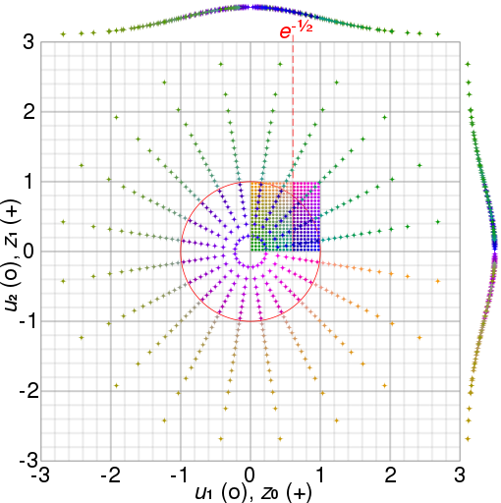
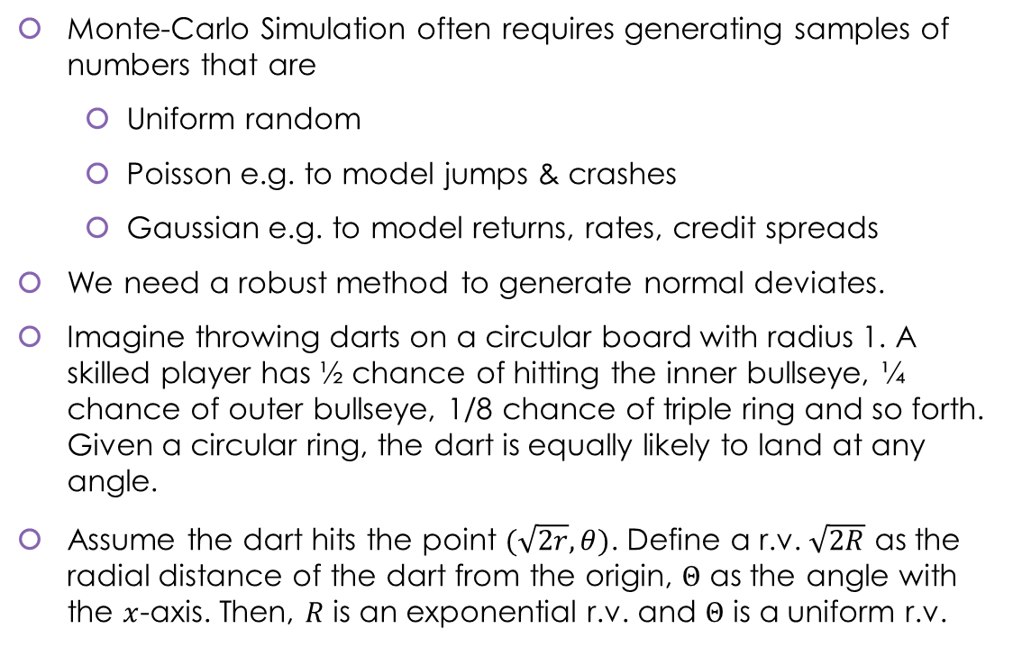
Generating normal deviates
Monte-Carlo Simulation often requires generating samples of numbers that are
Uniform random
Poisson e.g. to model jumps & crashes
Gaussian e.g. to model returns, rates, credit spreads
We need a robust method to generate normal deviates.
Imagine throwing darts on a circular board with radius 1. A skilled player has ½ chance of hitting the inner bullseye, ¼ chance of outer bullseye, 1/8 chance of triple ring and so forth. Given a circular ring, the dart is equally likely to land at any angle.
Assume the dart hits the point $(\sqrt{2r},θ)$. Define a r.v. $\sqrt{2R}$ as the radial distance of the dart from the origin, $Θ$ as the angle with the $x$-axis. Then, $R$ is an exponential r.v. and $Θ$ is a uniform r.v.

Slide 24

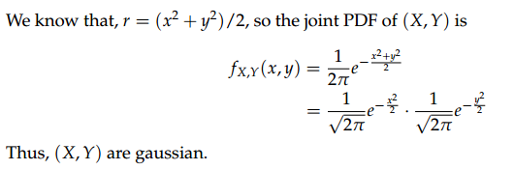

Generating normal deviates
Box-Muller transform to generate normal deviates
def getGaussian(mu,sigma,n):
# Generate a pair of uniform random variables U,V U = np.random.uniform(0,1,n) V = np.random.uniform(0,1,n)
# Get R~Exponential(1) and Theta~Uniform(0,2pi) random variables R = -np.log(U) Theta = 2*math.pi*V
# Transform to X and Y X = np.multiply(np.sqrt(2*R),np.cos(Theta)) Y = np.multiply(np.sqrt(2*R),np.sin(Theta))
# Perform location-scale transform X = mu + sigma*X Y = mu + sigma*Y
return X,Y
Apply the transformation $X=\sqrt{2R}\cos{Θ},Y=\sqrt{2R}\sin{Θ}$.
We see that, $X^{2}+Y^{2}=2R$, and $\frac{Y}{X}=\tan{Θ}$. We have transformed the point $P$ from polar co-ordinates $(R,Θ)$ to rectangular co-ordinates $(X,Y)$.
The joint density function is,

Slide 25
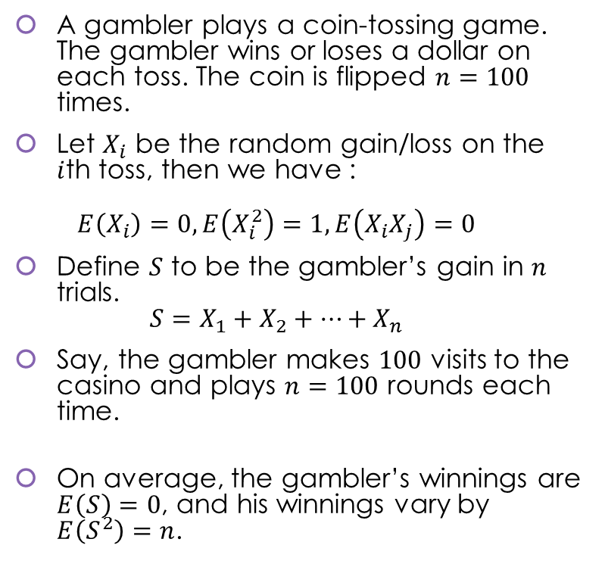
Chance fluctuations
A gambler plays a coin-tossing game. The gambler wins or loses a dollar on each toss. The coin is flipped $n=100$ times.
Let $X_{i}$ be the random gain/loss on the $i$th toss, then we have : $E\left(X_{i}\right)=0, E\left(X_{i}^{2}\right)=1, E\left(X_{i}X_{j}\right)=0$
Define $S$ to be the gambler’s gain in $n$ trials. $S=X_{1}+X_{2}+…+X_{n}$
Say, the gambler makes $100$ visits to the casino and plays $n=100$ rounds each time.
On average, the gambler’s winnings are $E\left(S\right)=0$, and his winnings vary by $E\left(S^{2}\right)=n$.
Simulation of the discrete time coin-tossing game
# Input parameters sample_space = [1,-1] x = list(range(0,101))
# 100 realizations of the gambler's gain for i in range(100): x_i = [0] s_i = [0]
# Flip a coin hundred times coin_tosses = np.random.choice(sample_space,100) x_i = np.append(x_i,coin_tosses)
# Take the cumulative sum s_i = np.cumsum(x_i)

Slide 26
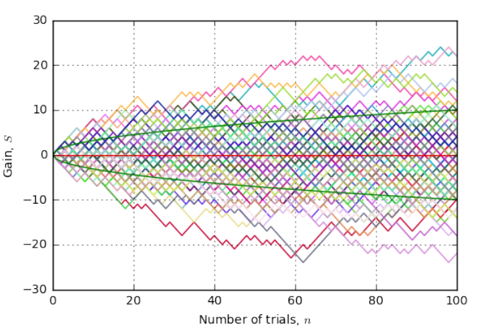
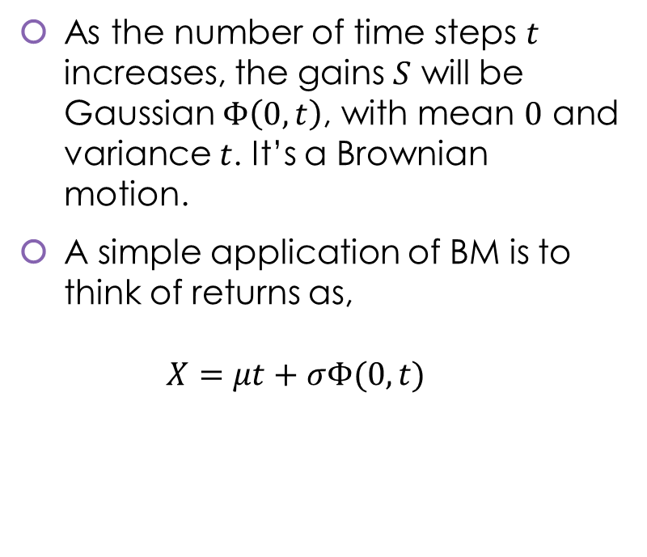
Chance fluctuations
As the number of time steps $t$ increases, the gains $S$ will be Gaussian $Φ\left(0,t\right)$, with mean $0$ and variance $t$. It’s a Brownian motion.
A simple application of BM is to think of returns as, $X=μt+σΦ(0,t)$
Continuous returns
=
Return in a bank account
+
Random component

Slide 27
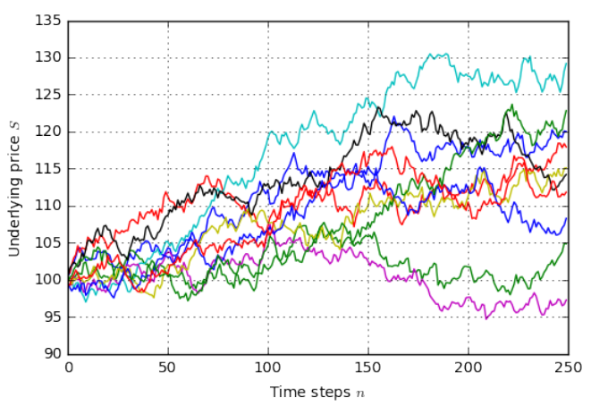
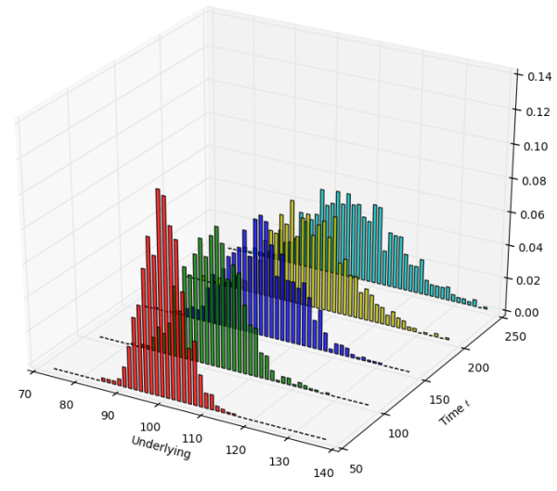
Implementing GBM
Generating Monte Carlo paths for a GBM
def gbm_mcs(mu=0.05, sigma=0.10, S0=100, T=1, n=250, noOfPaths=1000): S = [] delta_t = T/n
# Mean and variance of a lognormal random walk mean = S0 * np.exp((mu+(0.5*sigma**2))*T) variance = (S0 ** 2)*np.exp(2*mu*T + 2*(sigma ** 2)*T) \ *(np.exp(sigma**2)*T-1)
for i in range(noOfPaths): X,Y = getGaussian(0,1,n) dz_t = X dW_t = math.sqrt(delta_t) * dz_t dX_t = mu * delta_t + sigma * dW_t X_t = np.cumsum(dX_t) S_t = S0 * np.exp(X_t) S.append(S_t) S = np.array(S) return S, mean, variance

Slide 28
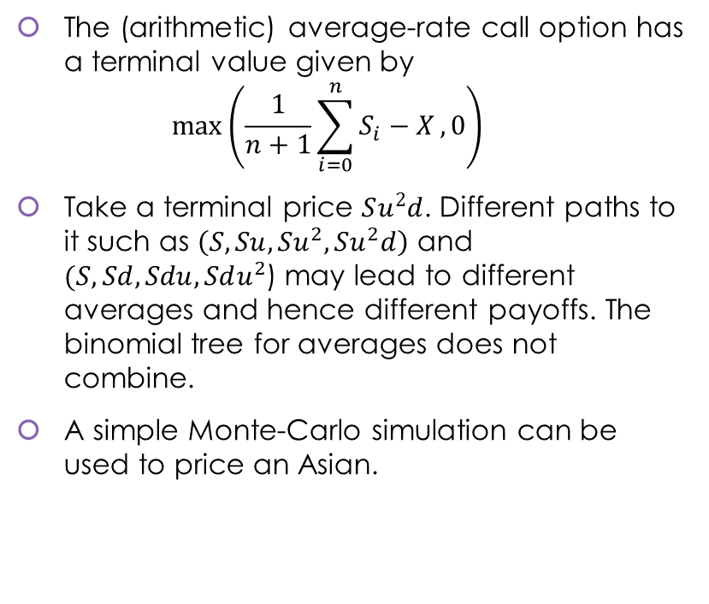
Pricing Asian(average-rate) options
Simple Monte Carlo to price an average rate option
# Simulate a lognormal random walk S,mean,variance = gbm_mcs(mu,sigma,S0,T,n,noOfPaths) C = 0.0 for i in range(noOfPaths): C = C + max(np.mean(S[i])-X,0)
disc = math.exp(-r*T) C = disc * (C/noOfPaths) print(C)
The (arithmetic) average-rate call option has a terminal value given by $max⁡\left(\frac{1}{n+1}\sum_{i=0}^{n}{S_{i}−X},0\right)$
Take a terminal price $Su^{2}d$. Different paths to it such as $\left(S,Su,Su^{2},Su^{2}d\right)$ and $(S,Sd,Sdu,Sdu^{2}$) may lead to different averages and hence different payoffs. The binomial tree for averages does not combine.
A simple Monte-Carlo simulation can be used to price an Asian.

Slide 29
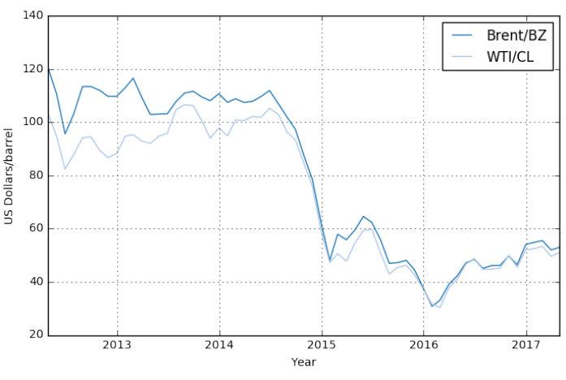
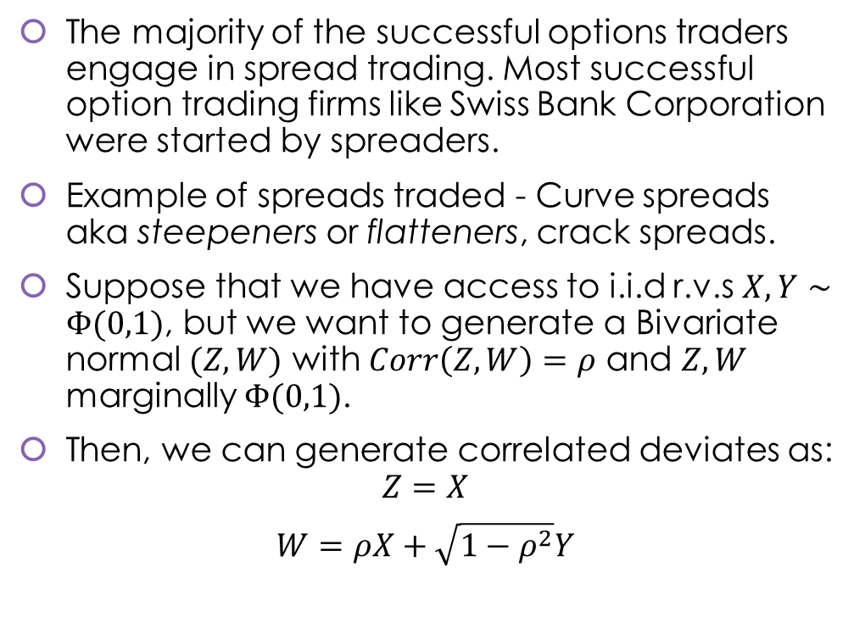
Spread trading and spread options
The majority of the successful options traders engage in spread trading. Most successful option trading firms like Swiss Bank Corporation were started by spreaders.
Example of spreads traded - Curve spreads aka steepeners or flatteners, crack spreads.
Suppose that we have access to i.i.d r.v.s $X,Y∼Φ(0,1)$, but we want to generate a Bivariate normal $(Z,W)$ with $Corr\left(Z,W\right)=ρ$ and $Z,W$ marginally $Φ(0,1)$.
Then, we can generate correlated deviates as: $Z=X$
$$W=ρX+\sqrt{1−ρ^{2}}Y$$

Slide 30
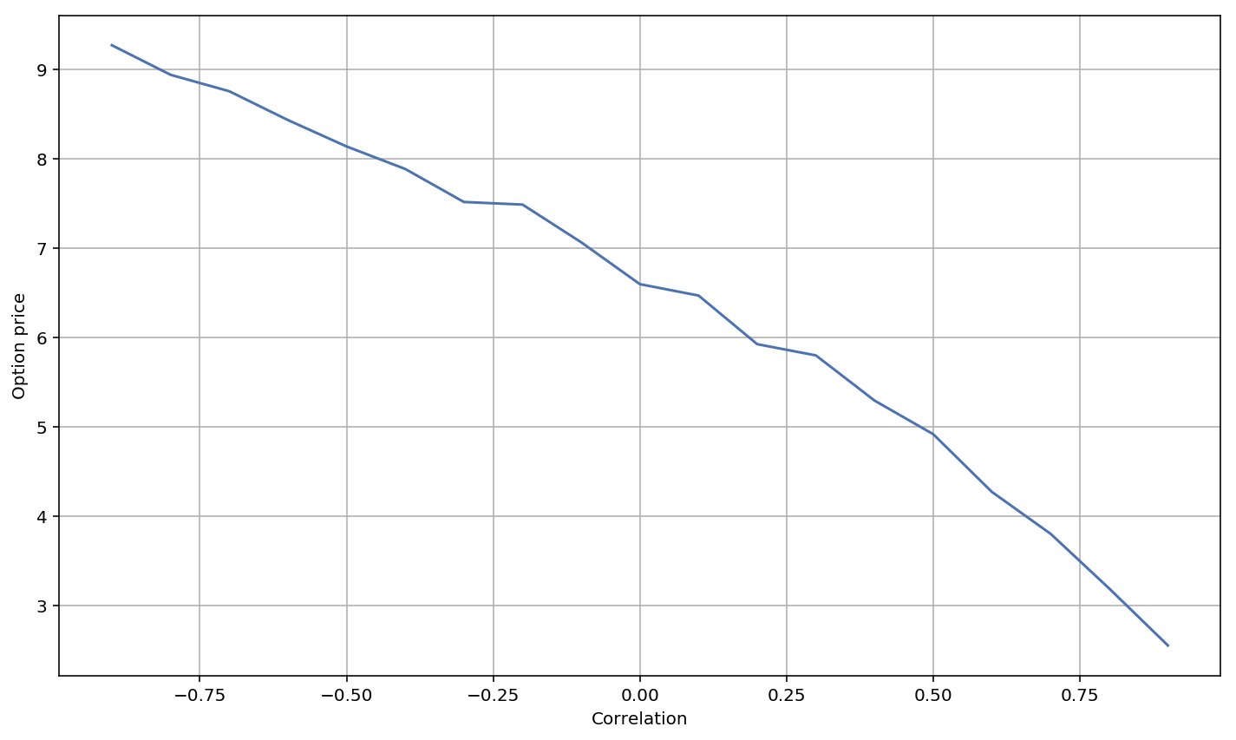
Pricing spread options
Pricing a spread option
def computeMCEuroSpreadOption(S1,S2,K,r,sigma1,sigma2, rho,T,n,noOfPaths,optType): sum = 0 disc = math.exp(-r*T)
for i in range(noOfPaths): dz1,dz2 = genCorrelatedGaussianDeviates(rho,n) dB1 = math.sqrt(dt)*dz1 dB2 = math.sqrt(dt)*dz2 dX1 = mu1 * dt + sigma1 * dB1 dX2 = mu2 * dt + sigma2 * dB2 X1_t= np.cumsum(dX1) X2_t= np.cumsum(dX2) S1_t= S1 * np.exp(X1_t) S2_t= S2 * np.exp(X2_t)
if (optType == 'C'): value = max(S1_t[-1] - S2_t[-1] - K,0) elif (optType == 'P'): value = max(K - S1_t[-1] - S2_t[-1],0)
sum = sum + value
C = disc * (sum/noOfPaths) return C

Slide 31
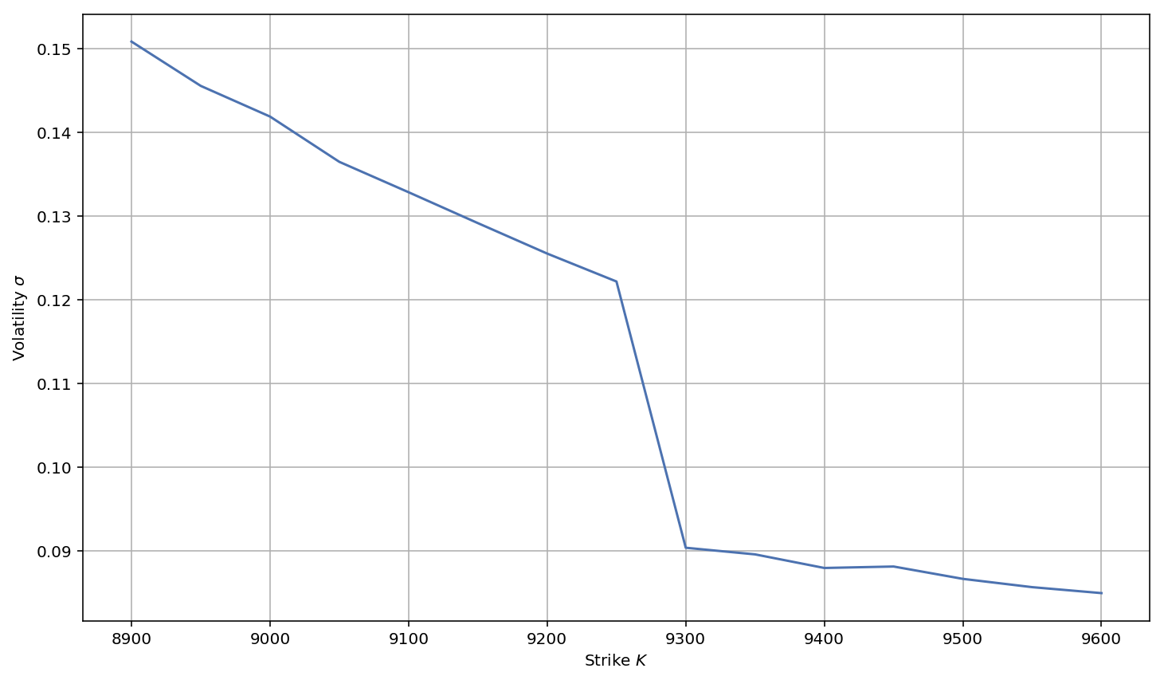
Smile Pricing
Root finding algorithm to solve for implied volatility
def findImpliedVol(S0,K,r,q,T,optType,Call_market):
# Parameters sigma_Lo = 0.01 sigma_Hi = 1.00 epsilon = 0.001 Call_BS_Lo = BS(S0,K,r,q,T,sigma_Lo,optType) Call_BS_Hi = BS(S0,K,r,q,T,sigma_Hi,optType) Call_BS_i = Call_BS_Lo
# Iteratively find a root using bisection method while abs(Call_BS_i - Call_market) > epsilon: sigma_i = sigma_Lo \ -((Call_BS_Lo - Call_market)\ *((sigma_Hi - sigma_Lo)/(Call_BS_Hi - Call_BS_Lo)))
Call_BS_i = BS(S0,K,r,q,T,sigma_i,optType)
if Call_BS_i > Call_market: Call_BS_Hi = Call_BS_i sigma_Hi = sigma_i else: Call_BS_Lo = Call_BS_i sigma_Lo = sigma_i
return sigma_i
The Black-Scholes assumption of constant volatility for all options is wrong.
Options with different moneyness levels and maturities have different volatilities.
FX option traders construct the smile to price options correctly.

Slide 32
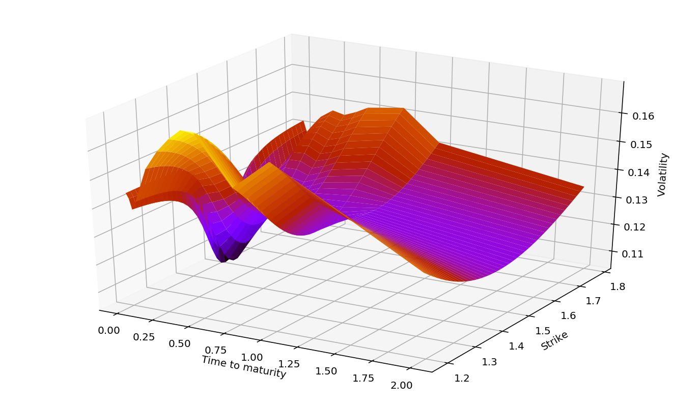
The Vanna-Volga method
As stochastic volatility models are computationally demanding, FX option traders use a faster – the Vanna-Volga method to create the vol surface.
The key idea is to add an analytical correction to the Black-Scholes price of the option.
What’s the extra cost to make the option neutral to vol changes? The surface should arb free!

